Slide 1

Project Too
Justin Liam Kristen Nicole Arianna

Slide 2
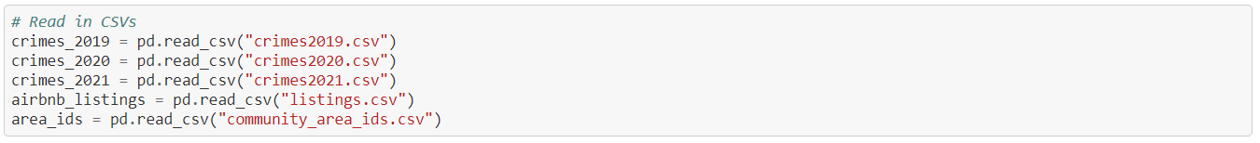
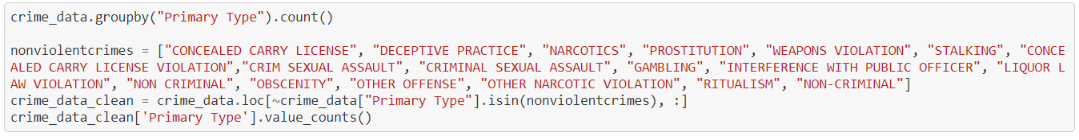
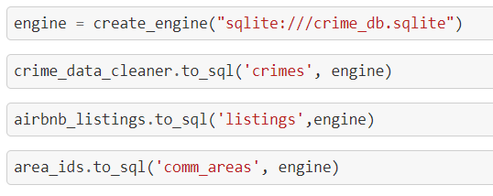
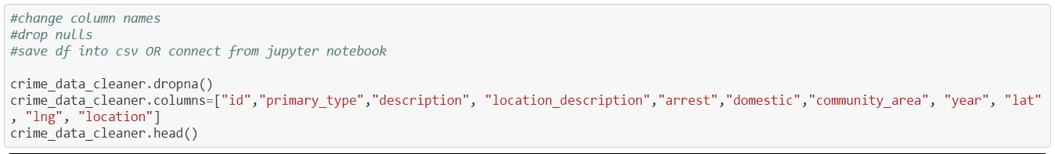
Data cleaning
Loaded CSV
Filtered data
Eliminated any redundancies

Slide 3
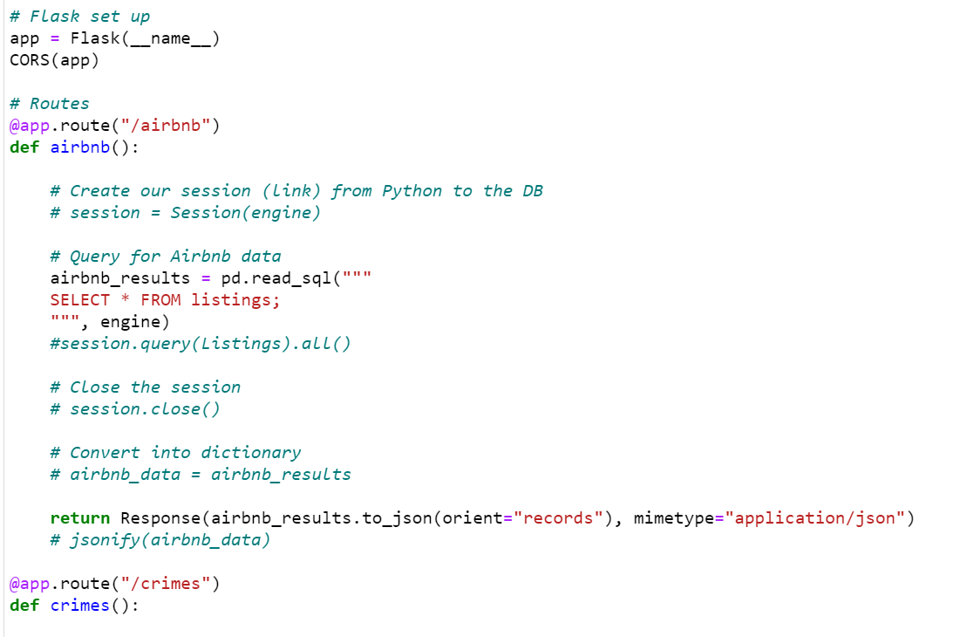
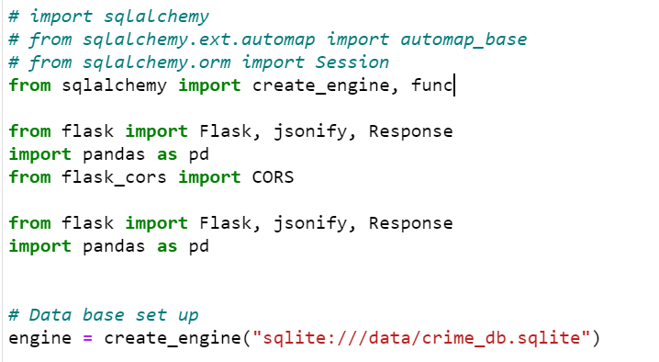
SQLITE – FLASK CONNECTION

Slide 4
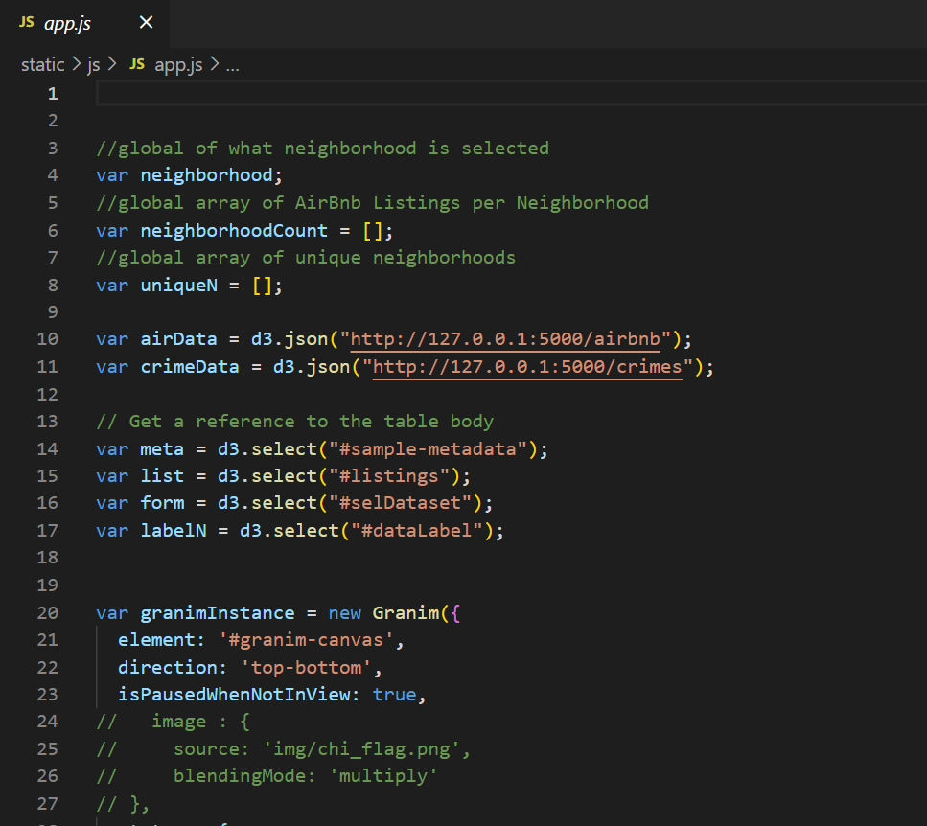
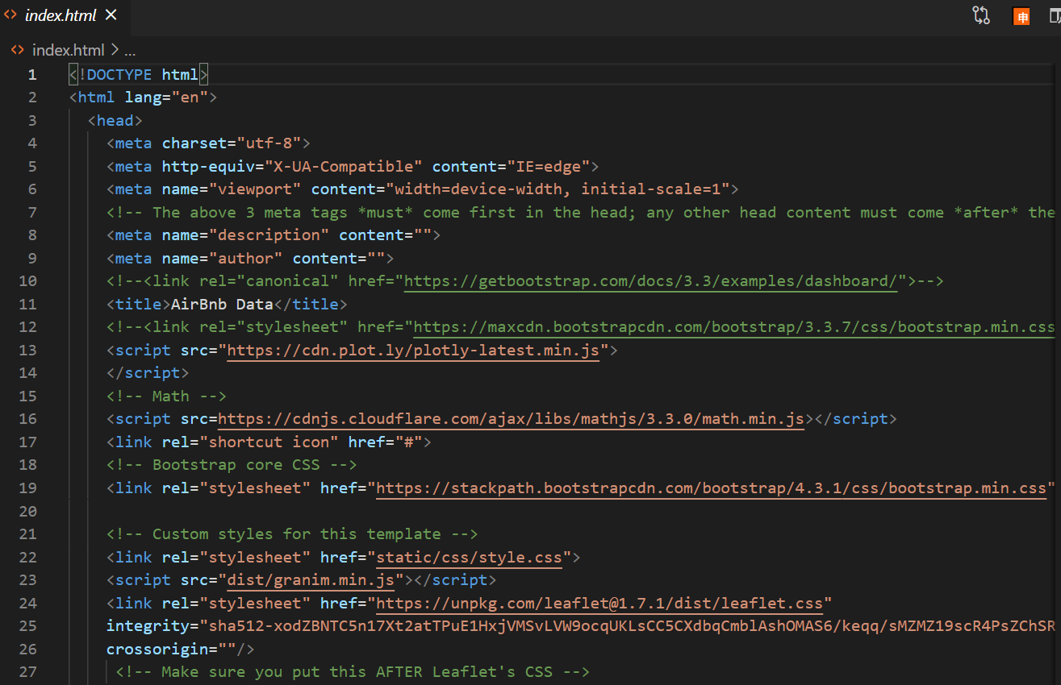
Html - js

Slide 5
Further Exploration
With more time/resources, we would have liked to build:
A scatterplot of crime volume per neighborhood and Airbnb price
A filter by crime type within the map
Sorting/filtering within the table
With more time/resources, we would have liked to explore:
Crime data by neighborhood
Airbnb & Crime data YoY
Covid impact on both Airbnb listings and crime rate

